Slide 1


BSCS FINAL PROJECT
Email Server Pro

Slide 2
Project Advisor
Mr. Waqas Arshad
Presented by:
Group ID: F21BS086
Student Reg# Student Name
L1F18BSCS0059 Muhammad Hussain Kamran
L1F18BSCS0089 Amjad Khan
L1F16BSCS0351 Muhammad Bilal Imtiaz

Slide 3
Product
Email applications like Gmail, outlook, yahoo, none of these applications have inbuilt features like Unsend, email seen status and many more and you cannot send large files only 25mb is allowed in most of them.
They use extensions to use all of these features but our email service will provide these features without any extension.
Email service providers are gradually making improvements. Email server pro is a big step ahead of all these providers, users have some issue with the way email applications work, email server pro provides everything users need.

Slide 4
Objective
An email system which will allow users to feel more comfortable while sending an email, they would know if something went wrong in email, they could change it afterwards and more advanced features will facilitate our users.

Slide 5
Product Features
User will be able to unsend Email within 180 seconds.
Seen status will be available for users.
Abusive words will be automatically blocked.
User can add handwritten signatures.
Users will be able to send file upto 100mbs data.
If screenshot is taken user will be notified.

Slide 6
Scope
The scope of our email server is :
optimization,
software engineering
JavaScript
Security
Php
programming languages and website application development using HTML, CSS.
For storage of data in our system we will use sql for now.

Slide 7
Future Scope
The project will enhance the security of the mailing server by using secured connection.
This project can be enhanced more by applying graphic affect to the data that is sent over the network.
The project will provide a secure connection over the network by authenticating the user so that there is more security in this project.

Slide 8
Business Goals
Our application (Email Server Pro) will be directly competing with the giants of the email industry and they are providing services for free but our business will be generating money by running ads on our application on web and mobile but those ads won’t be irritating for the users.
Starting with minimum revenue requires ads most of the time but as we grow in future, we might turn off all the ads and convert it to complete business model with good amount of revenue.

Slide 9
Other Design Details
As the project is a software-based application therefore the software consists of many components and every component is briefly described in the document.
Our application has a web version which requires different software’s. This website is also a responsive website which works perfectly fine on mobile browser as well as on personal computer.
This website is deployed on a domain which allows us to see real time changes. This application consists of two portal one for admin and other for users.

Slide 10
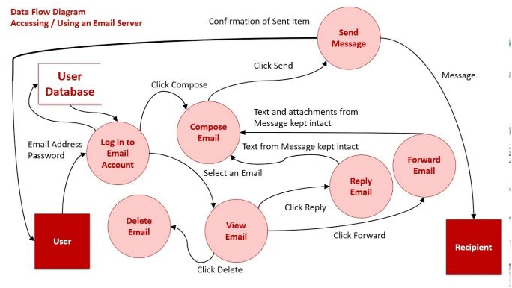
Data Flow Diagram

Slide 11
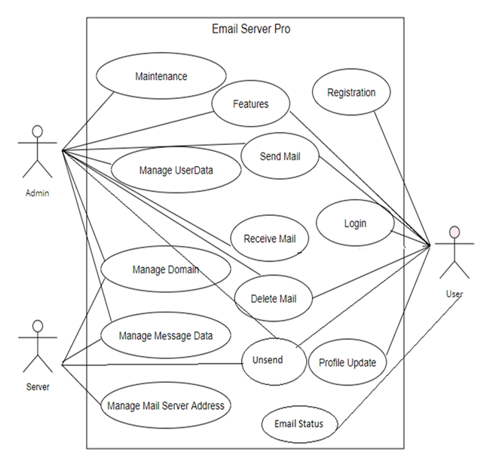
Use Case Diagram

Slide 12
Guide
User will open any browser and search for emailserverpro and will use email services.User will see first page appear as sign up/login page. If the user hasn’t had an account, he/she will have to sign up by filling the credentials there. Upon the successful creation of account, the home screen will appear. If the user has an account already, he/she will have to login before proceeding to the home page. In case the user forgot his/her password, the feature to recover the password will be added later. In order to send 100mbs of data user will select attach button and it will take you to personal computers drives where you select data . To add signatures user will log in into email application by providing email address and password, after sign in user will select compose email from the top right corner of the screen and add the email address of the receiver and subject of the email and message of the email and attachment option will be optional for the user and user will see the signature option right above the attachment option personal computer will take user to user data from where user will select the required signature and send it to the receiver and other components of the email as well.

Slide 13
Screens

Slide 14
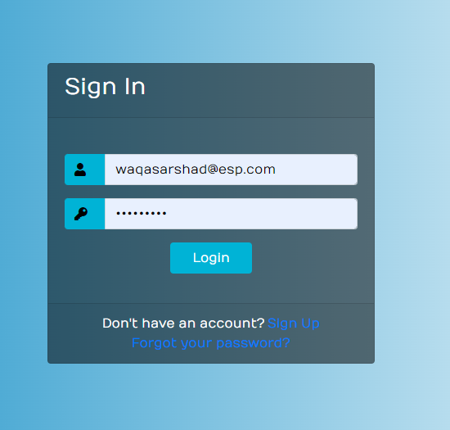
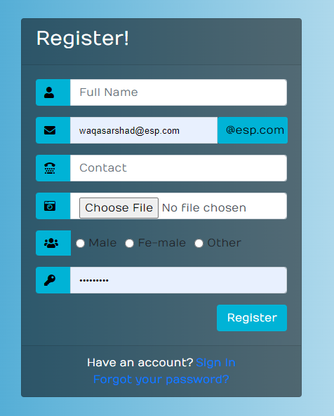
Sign in/sign up

Slide 15
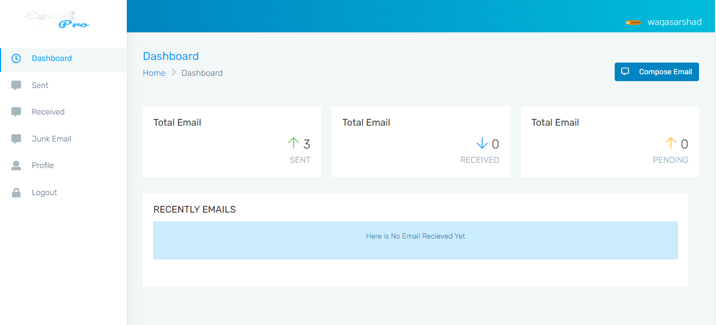
Dashboard

Slide 16
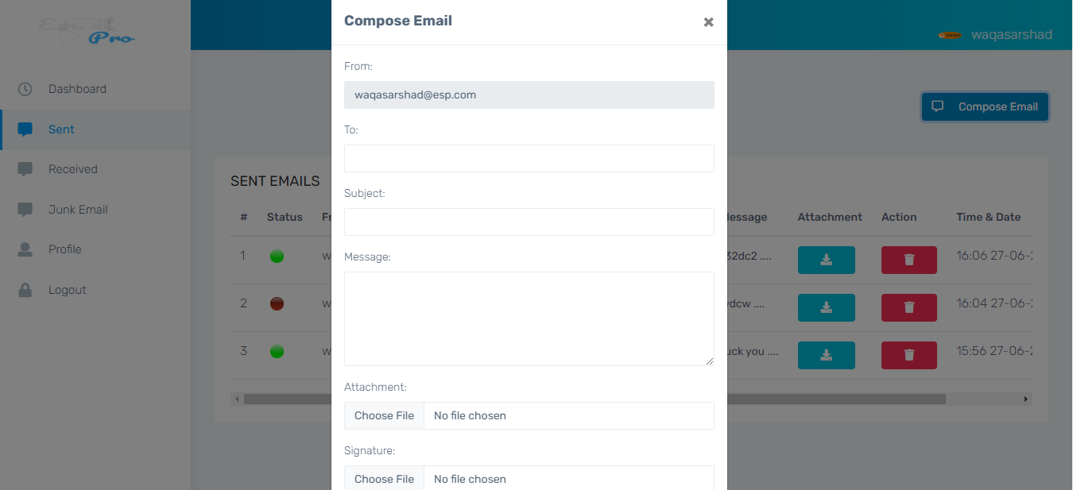
Compose Email

Slide 17
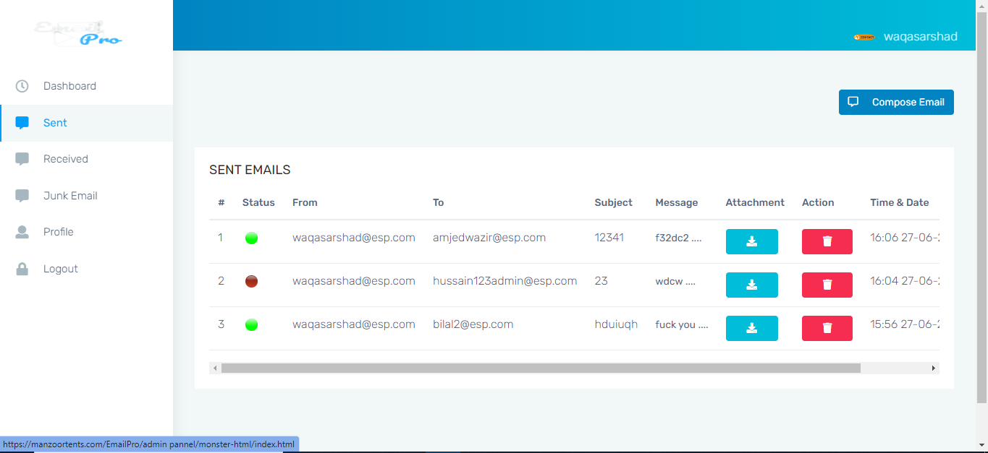

Slide 18
Conclusion
We are trying our best to give users a best version of email system with attractive features.
Its an ease for user to use multiple advance features in email system and they don’t even have to use any extension or drives.

Slide 19


